Slide 1
BLOCKCHAIN IN EHR
Submitted By
VISHNU SUDHAKARAN
Reg.No: 1524043

Slide 2
Aim Of The Project
To know and understand the Blockchain Technology.
To implement the Blockchain Technology in a domain.

Slide 3
About The Project
Blochchain In Electronic Health record

Slide 4
About The Project
The project “ Blockchain In Electronic Health Record” is an online portal.
Its basic purpose is to store the details of the client information for the insurance companies.
Here client is the patient.
Only the basic information is stored.

Slide 5
Purpose of the Project
Data of the client is stored in the blockchain.
The data can be accessed from the blockchain when needed.
Data can’t be visible for outsiders.
Once the data is entered the particular block cannot be edited.
Once the transaction done then it is immutable.

Slide 6
Blockchain EHR vs Normal EHR
Distributed network
Data is immutable.
Each and every transaction is mapped.
Whoever in the contract can view the data.
Data is highly secured.
Centralized network.
Data is not immutable.
No transaction mapping.
Only authorized access for view.
Data is secured?

Slide 7
About The Technology
Blochchain In Electronic Health record

Slide 8
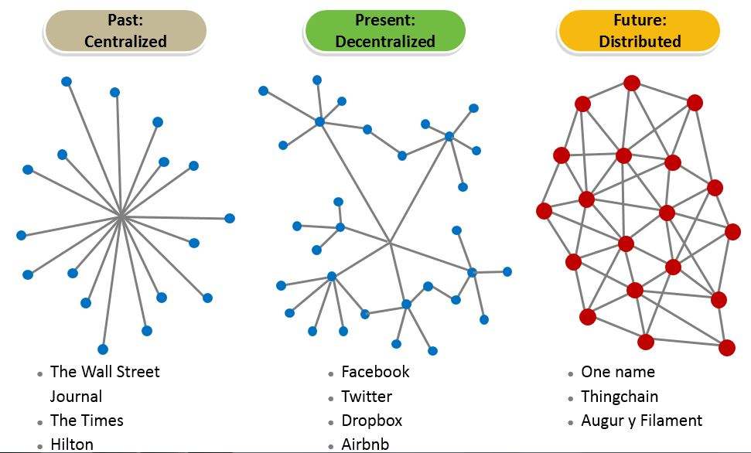
Blockchain Technology

Slide 9
Five key forces of Blockchain technology
Establishing transparent P2P transaction
Promoting dynamic efficient pricing
Enabling smart contracts
Blockchain
Technology
Establishing a reputation system
Allowing micrometering & micro monetizing

Slide 10
How It Works
1
2
3
Someone requests a transaction
The requested transaction is broadcast to a P2P network consisting of computers, known as nodes
The network of nodes validate the transaction using cryptography.
6
5
4
The transaction is complete
The new block is then added to the existing blockchain.
Once verified, this transaction is represented as a new block.

Slide 11
Blockchain
Blockchain technology is a digital innovation that is poised to significantly alter financial markets within the next few years, within a cryptographic ecosystem that has the potential to also significantly impact trusted computing activities and therefore cybersecurity concerns as a whole.

Slide 12
Three “Levels” of Blockchain
Storage for digital records
Exchanging digital assets (called tokens)
Executing smart contracts
Ground rules – Terms & conditions recorded in code
Distributed network executes contract & monitors compliance
Outcomes are automatically validated without third party

Slide 13
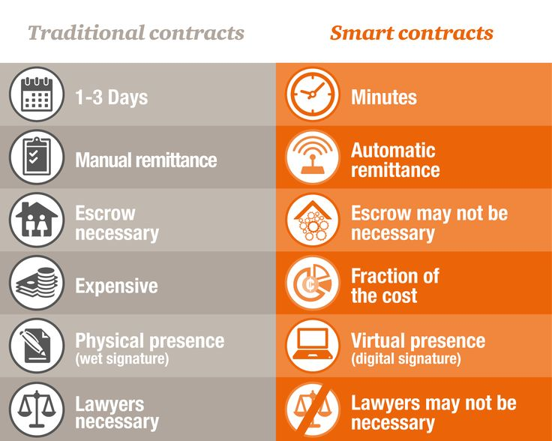
Smart Contract
Simple contract between two or more untrusted parties contracts that will execute when specified conditions are met.
Its a piece of computer code which runs on every node in a blockchain
Smart contracts can be programmed to perform simple functions.

Slide 14
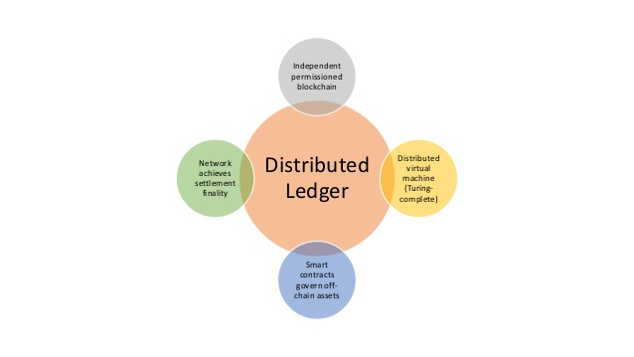
Distributed Ledger Technology (DLT)
Information held on a blockchain exists as a shared — and continually reconciled — database.
The blockchain database isn’t stored in any single location, meaning the records it keeps are truly public and easily verifiable.
No centralized version of this information exists for a hacker to corrupt.
Users of Distributed Ledger Technology (DLT) significantly benefit from the efficiencies and economics by creating a more robust environment for real-time and secure data sharing.

Slide 15
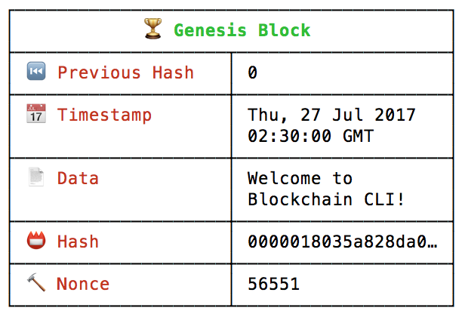
Block Structure

Slide 16
Major Tools
Front End
Back End
HTML
CSS
Nodejs
Web3Js
Solidity
Platform
Ethereum
Editor
Sublime

Slide 17
Ethereum
Ethereum is an open-source, public, blockchain-based distributed computingplatform.
Ether is the token used in the Ethereum platform.
One ether is around 1100 dollar.
Using “proof of work” as the consensus algorithm.
Ethereum is Based on Three Main Concepts: Smart-Contracts, Decentralized Applications and Decentralized Autonomous Organizations

Slide 18
Solidity
Solidity is a contract-oriented, high-level language for implementing smart contracts.
It is worked with Ethereum Virtual Machine.
Solidity is statically typed, supports inheritance, libraries and complex user-defined types among other features.
Remix is an online IDE for solidity.
Not easy to get proper tutorials.

Slide 19
Diagrams
Blochchain In Electronic Health record

Slide 20
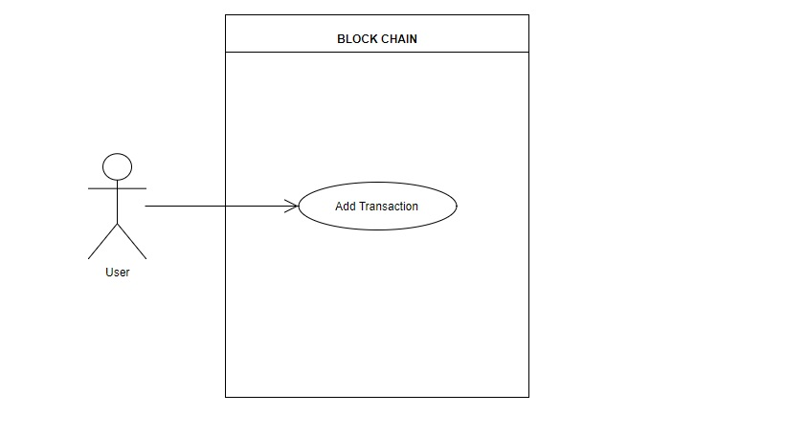
Use Case Diagram

Slide 21
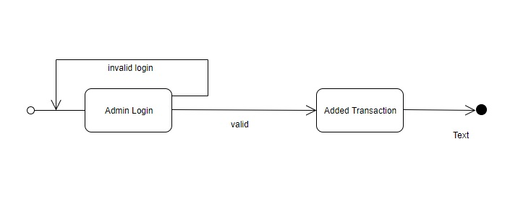
State Diagram

Slide 22
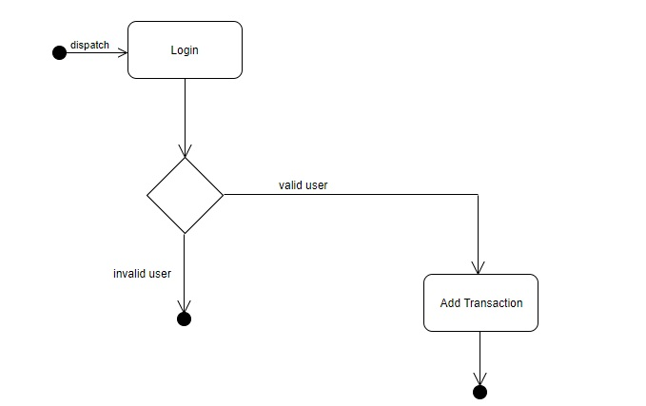
Activity Diagram

Slide 23
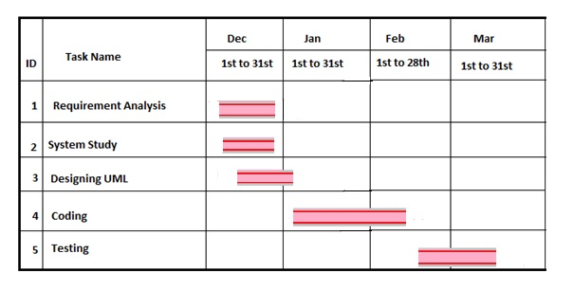
Gantt Chart

Slide 24
Sample Forms
Blochchain In Electronic Health record

Slide 25
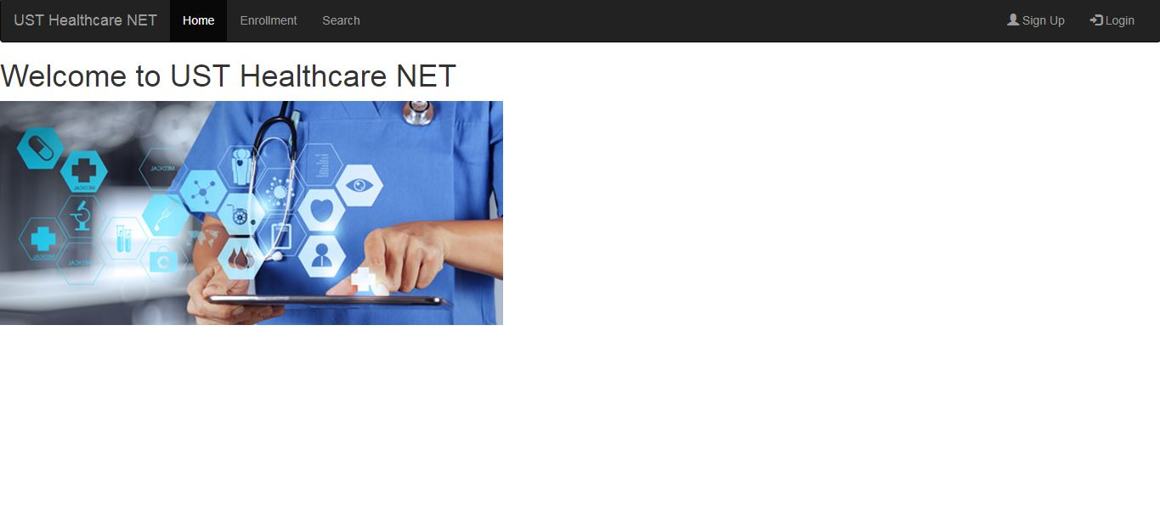
Home

Slide 26
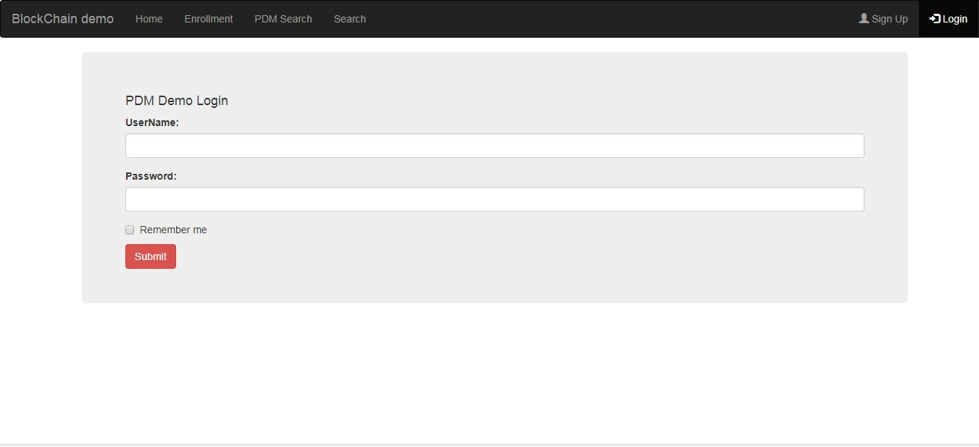
Login

Slide 27
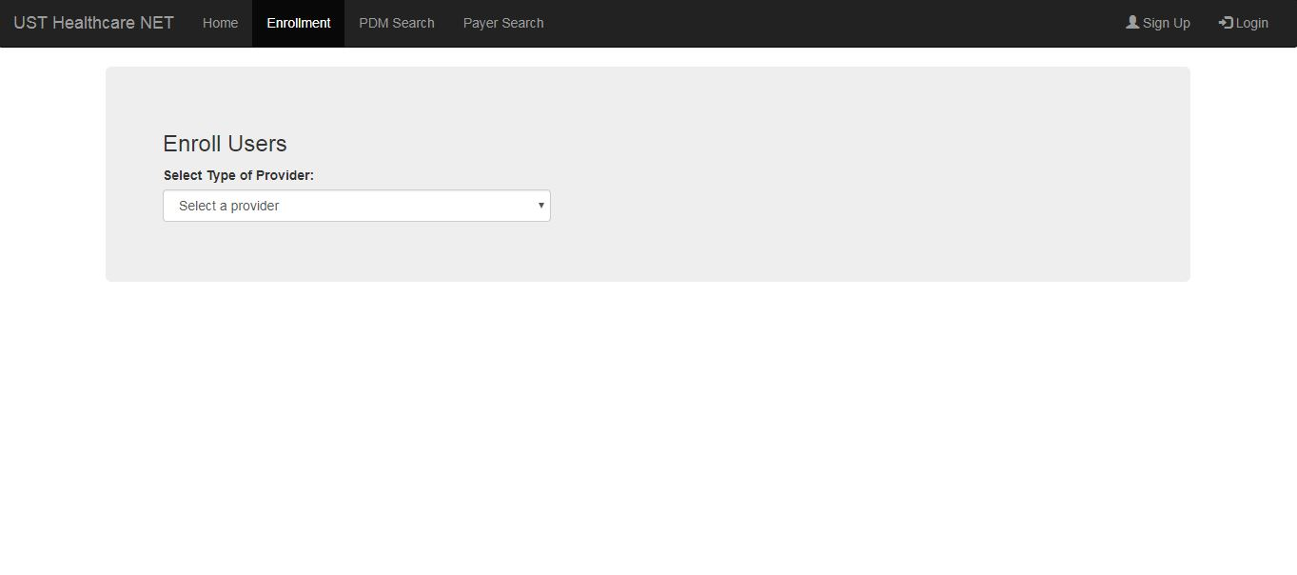
Adding

Slide 28
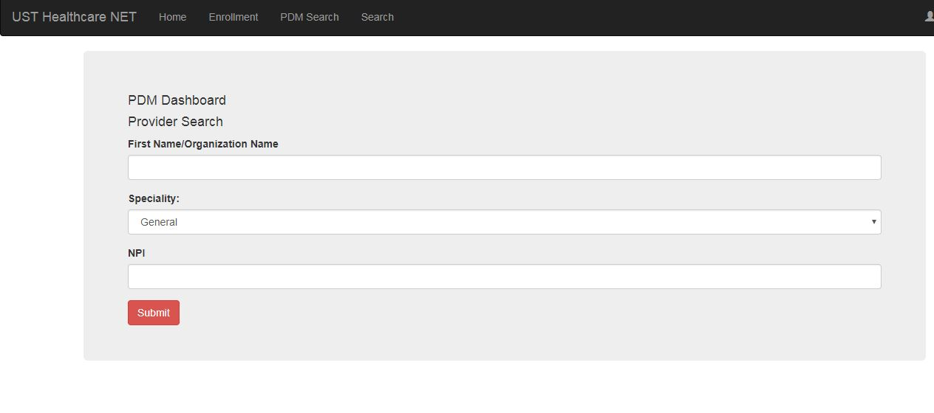
Searching

Slide 29
Title and Content Layout with Chart

Slide 30
Two Content Layout with Table
First bullet point here
Second bullet point here
Third bullet point here
Class | Group 1 | Group 2
Class 1 | 82 | 95
Class 2 | 76 | 88
Class 3 | 84 | 90

Slide 31
Title and Content Layout with SmartArt
Step 1 Title
Step 2 Title
Task description
Task description
Task description
Task description
Task description
Task description
Task description
Step 3 Title
Task description
Task description
Step 4 Title
Task description
Task description

Slide 32
Add a Slide Title - 1

Slide 33
Add a Slide Title - 2

Slide 34
Add a Slide Title - 3

Slide 36
Add a Slide Title - 4

Slide 37
Add a Slide Title - 5

